Slide 1

AI 전문가 교육과정 : Learning Algorithms I (Meta-Learning - Lab)
Hongjoon Ahn, Sangwon Jung
Hongjoon0805@gmail.com, toto6599@naver.com
Department of Electrical and Computer Engineering

Slide 2
Outline
Review of MAML and CNP
Goal of Lab
A Brief Explanation for Source Codes

Slide 3
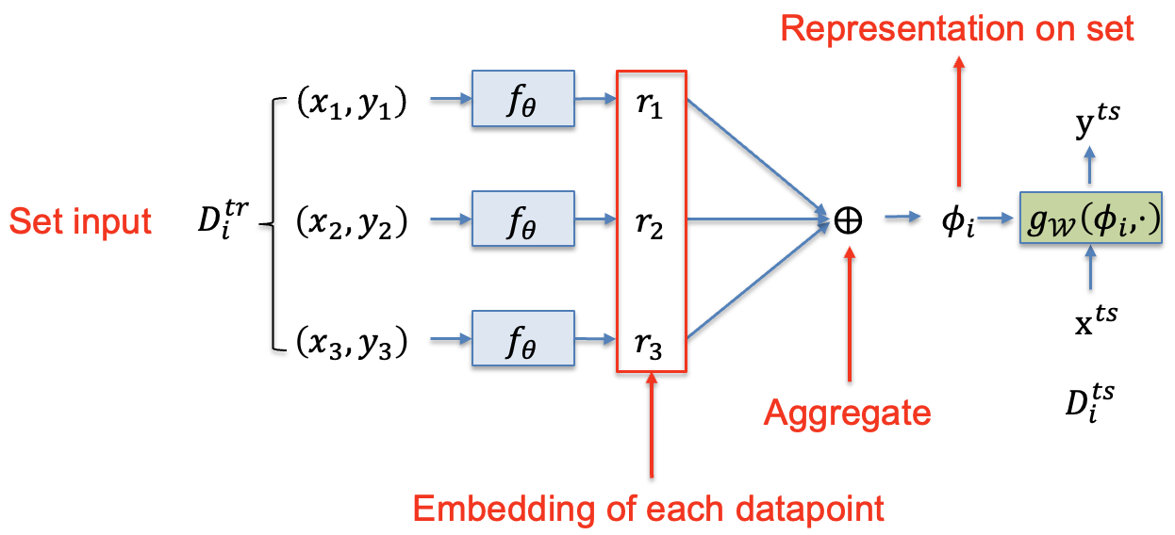
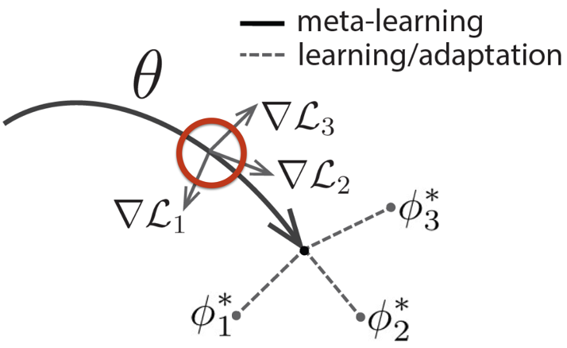
Topic for Lab
In this lecture, we cover two methods of model-based and optimization-based meta-learning approaches
Model-based - Conditional Neural Processes (CNP)
Optimization-based - Model Agnostic Meta-Learning (MAML)
Model-based
Optimization based

Slide 4
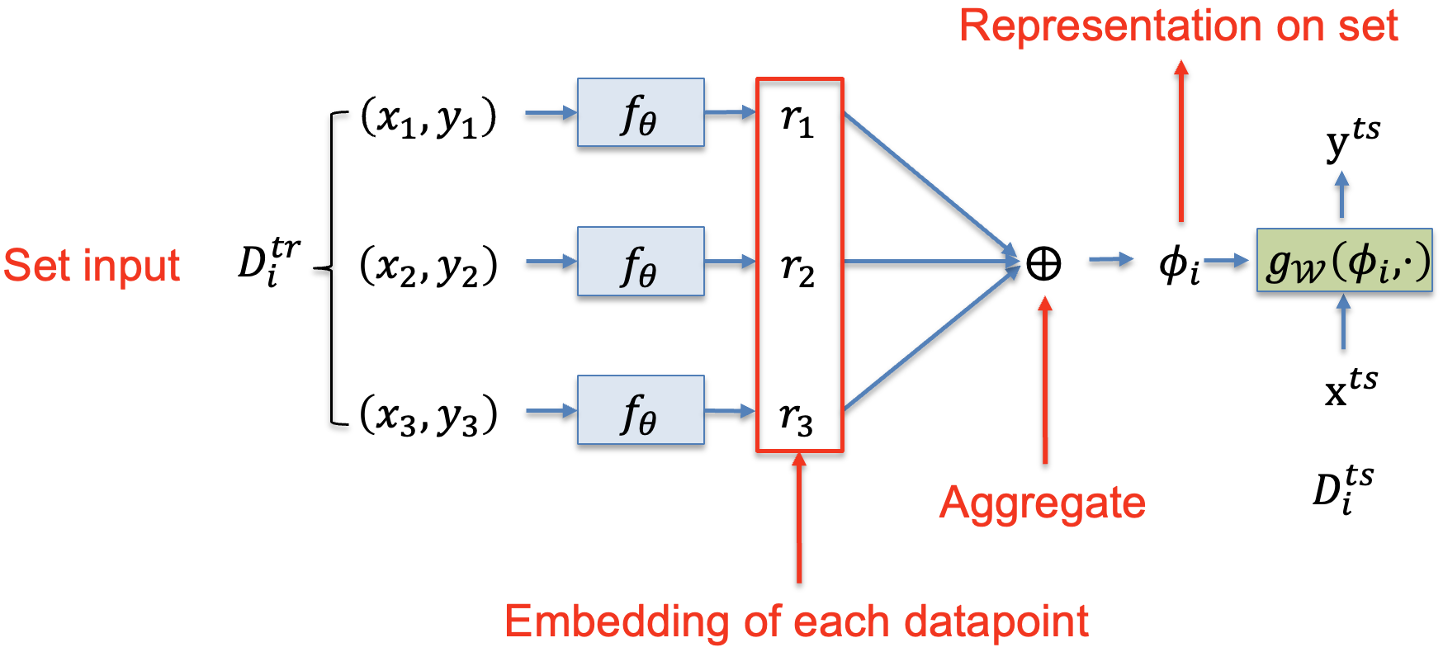
Conditional Neural Processes (CNP)
Meta-learning procedure in CNP
CNP takes a set of training data and tries to produce the representation that contains the information of training data.

Slide 5
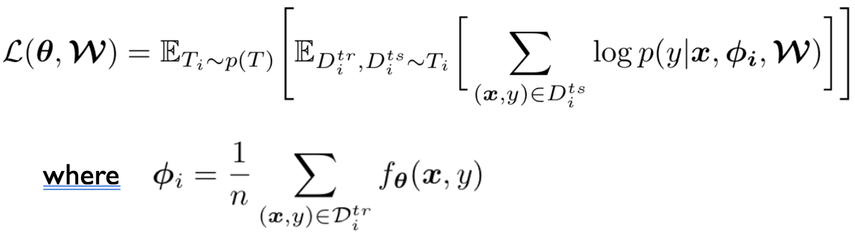

Conditional Neural Processes (CNP)
Meta-learning procedure in CNP
Loss function
The key point of CNP is to produce $φ_{i}$ and perform a task using $φ_{i}$

Slide 6
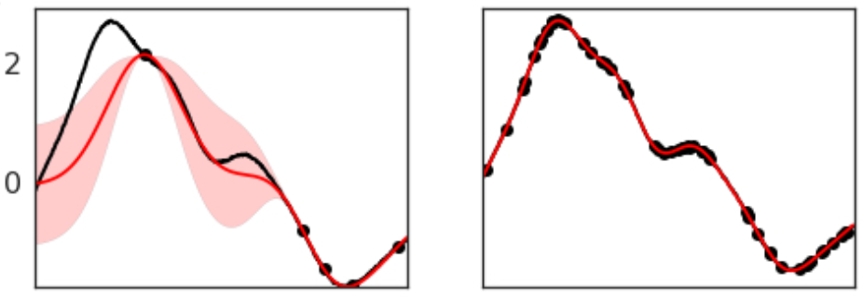
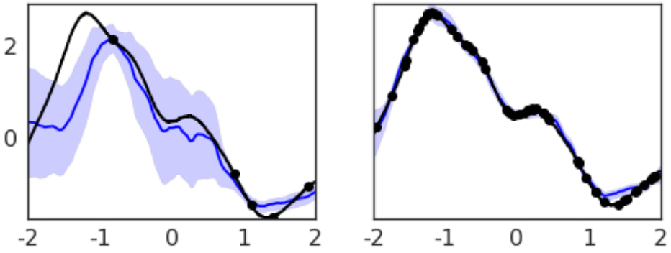
Conditional Neural Processes (CNP)
CNP performs well in few-shot regression task
1-D regression task
# context points
5 points
50 points
GP (best)
CNP

Slide 7
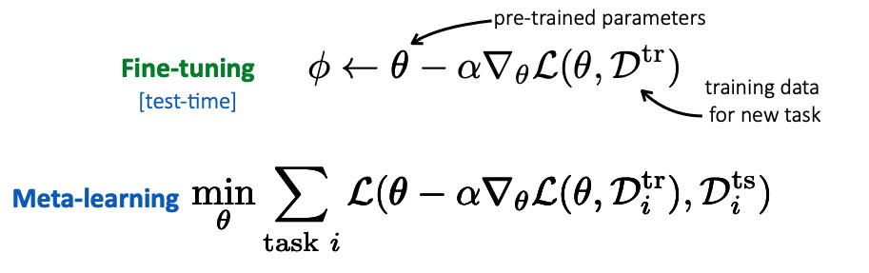
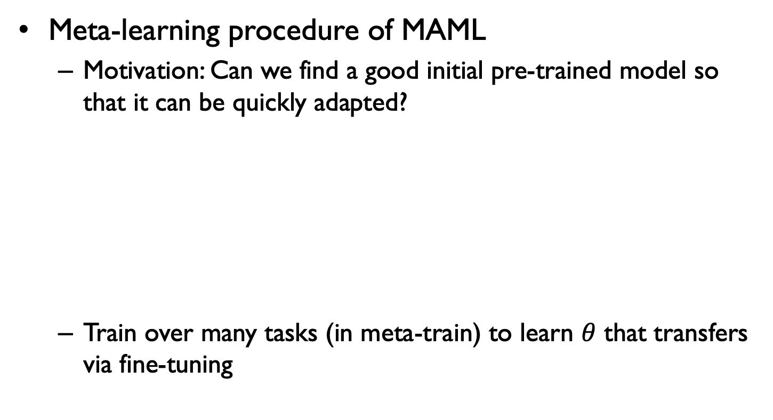
Fine-tuning for meta-learning
Meta-learning procedure of MAML
Motivation: Can we find a good initial pre-trained model so that it can be quickly adapted?
Train over many tasks (in meta-train) to learn $θ$ that transfers via fine-tuning

Slide 8
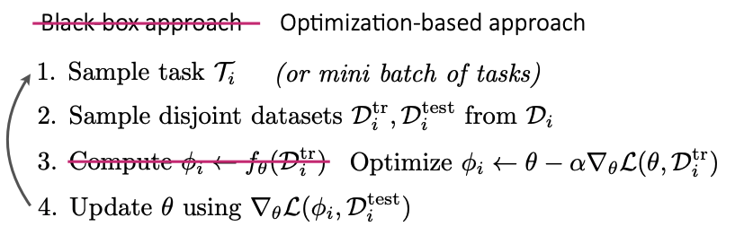
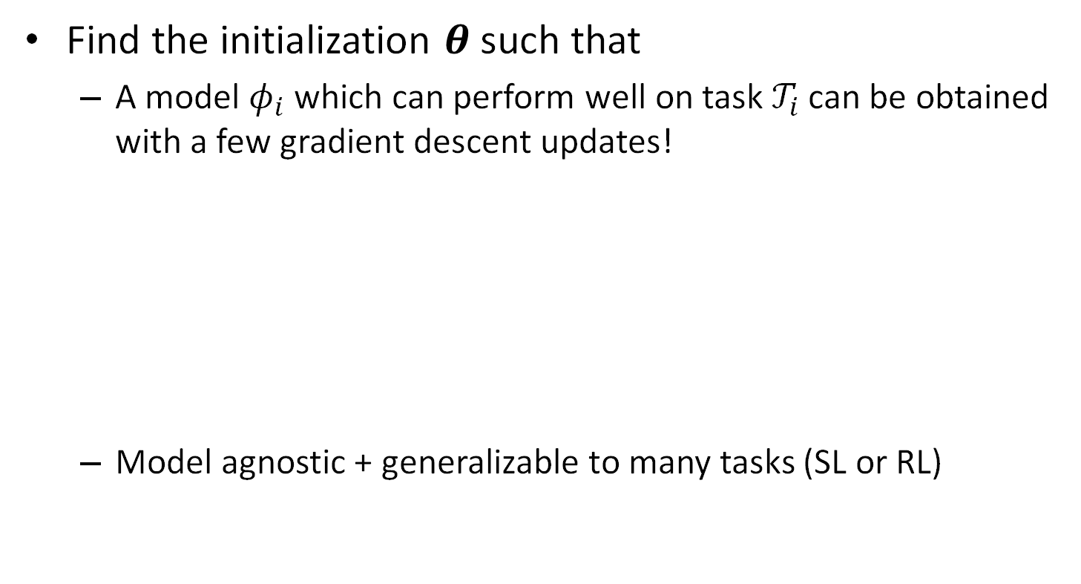
Model-Agnostic Meta-Learning (MAML)
Find the initialization $θ$ such that
A model $φ_{i}$which can perform well on task $𝒯_{i}$ can be obtained with a few gradient descent updates!
Model agnostic + generalizable to many tasks (SL or RL)
[Finn et al, Model Agnostic Meta-Learning for Fast Adaptation of Deep Learning, ICML, 2017]

Slide 9
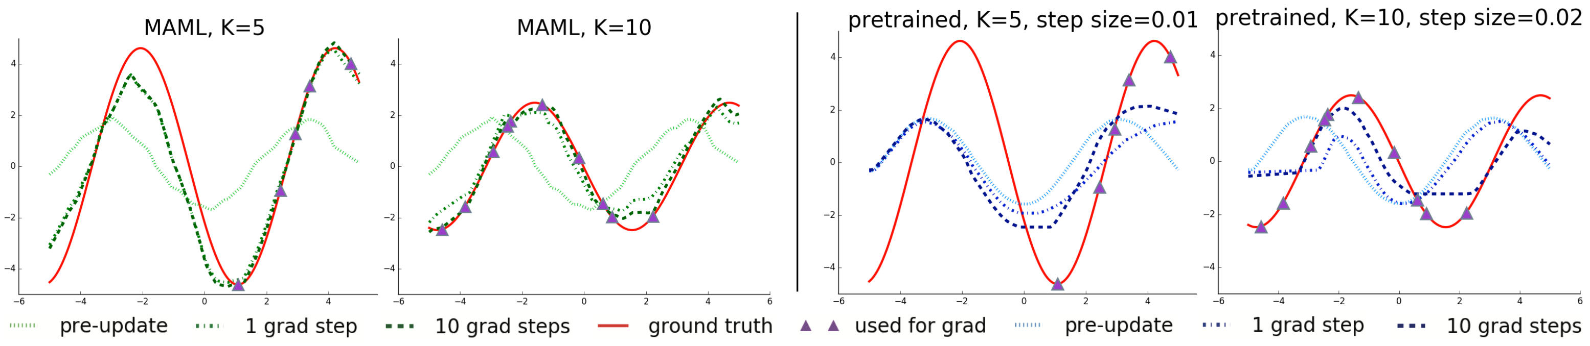
Model-Agnostic Meta-Learning (MAML)
MAML performs well in few-shot regression task
1-D regression task
After few updates, a model can adapt a novel sine-wave function with few training samples

Slide 10
Outline
Review of MAML and CNP
Goal of Lab
A Brief Explanation for Source Codes

Slide 11
Goal of Lab for CNP
Experimental Setting
Meta-learning task: few-shot regression on sine-wave dataset
Complete unimplemented functions of CNP
Implement two functions in day2_CNP.ipynb
__init__(self, ninput=1, noutput=1)
forward(self, x_spt, y_spt, x_qry)
Plot a figure for the results

Slide 12
Goal of Lab for CNP
Implement two function
__init__(self, ninput=1, noutput=1) : implement the network architecture of CNP
forward(self, x_spt, y_spt, x_qry): implement the forward propagation procedure of CNP
Details on the encoder-decoder architecture
Encoder: 3-hidden layers with 128 nodes
Decoder: 2-hidden layers with 128 nodes
Activation: ReLU
When computing the aggregated representation, use pre-activation features

Slide 13
Goal of Lab for CNP
Details on the encoder-decoder architecture
Aggregation
MLP
2
X
128
MLP
128
X
128
MLP
128
X
128
MLP
128
X
128
MLP
129
X
1
MLP
128
X
128
MLP
128
X
1
x
R
e
L
U
R
e
L
U
R
e
L
U
R
e
L
U
R
e
L
U
r
y
x
Training
data
Test
data

Slide 14
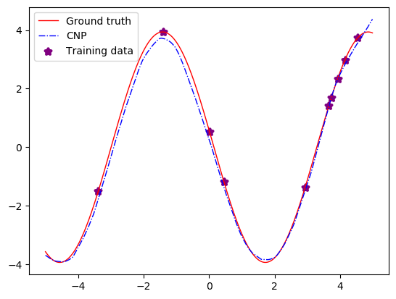
Goal of Lab for CNP
Results
You need to get the results as follows:
The shape of sine-wave could be different from this figure because of the randomness of dataset generation

Slide 15
Goal of Lab for MAML
Experimental Setting
Network architecture: 2-layer MLP network
Meta-learning task: few-shot regression on sine-wave dataset
Complete unimplemented functions of MAML
Implement two functions in day2_MAML.ipynb
inner_loop(self, model, inner_steps, x_spt, y_spt)
Meta_Train(self, x_spt, y_spt, x_qry, y_qry)
Plot a figure for the results

Slide 16
Goal of Lab for MAML
Implement three functions
inner_loop(self, model, x_spt, y_spt): implement the inner-loop of MAML with inner_step=1
Meta_Train(self, x_spt, y_spt, x_qry, y_qry): implement the meta-training procedure of MAML
Please use the function “inner_loop” to implement the overall procedure of meta-training of MAML

Slide 17
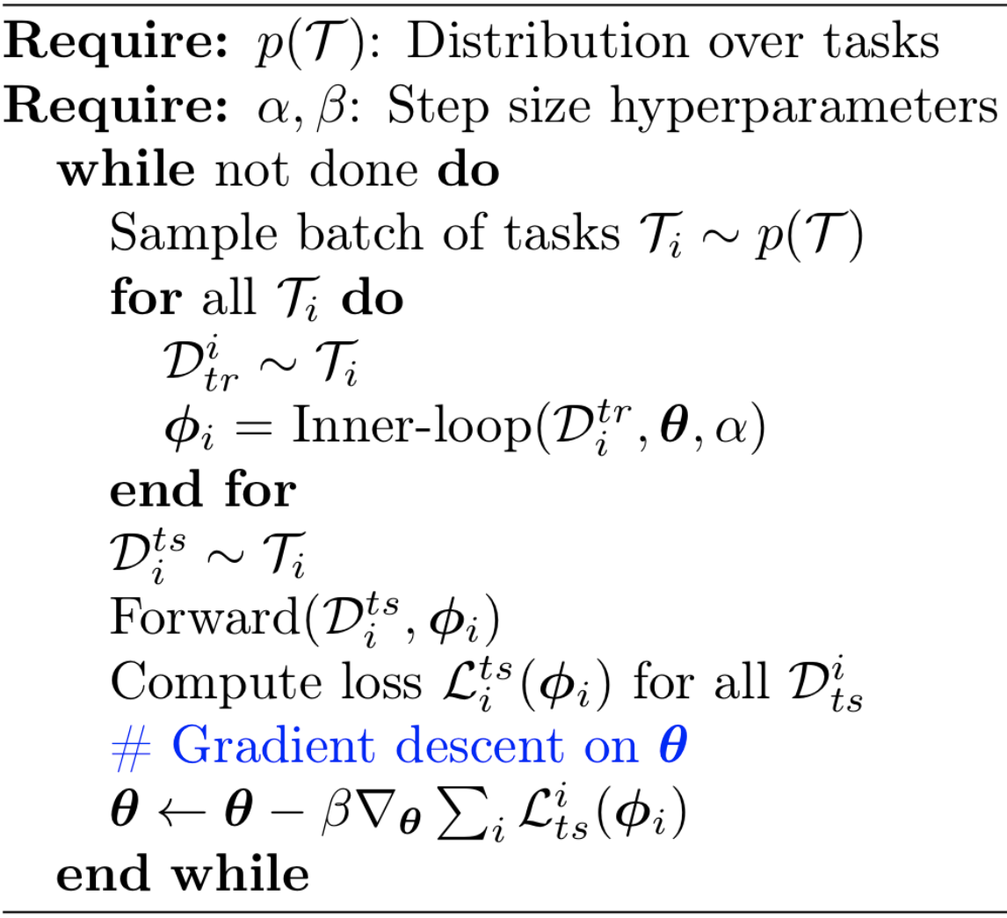
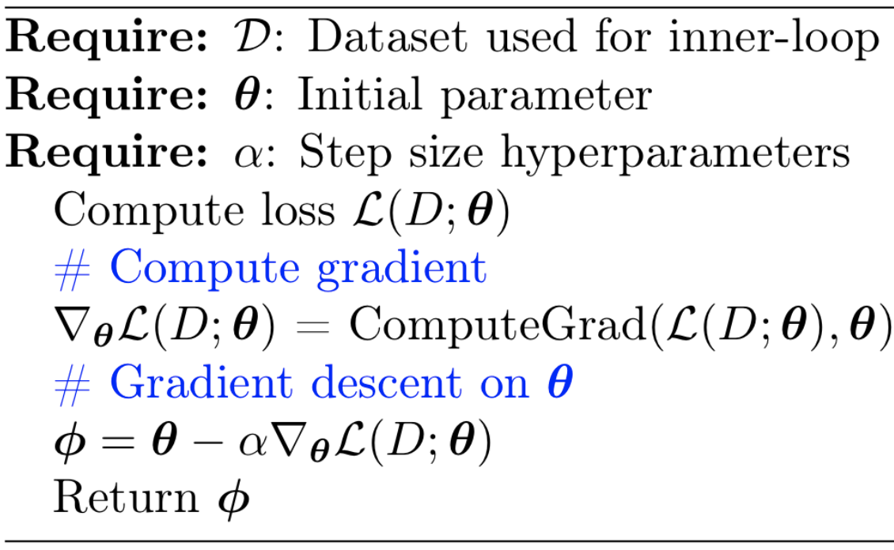
Goal of Lab for MAML
Pseudo code of MAML
Meta_Train
Inner_loop

Slide 18
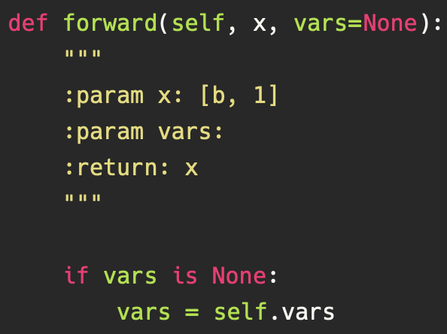
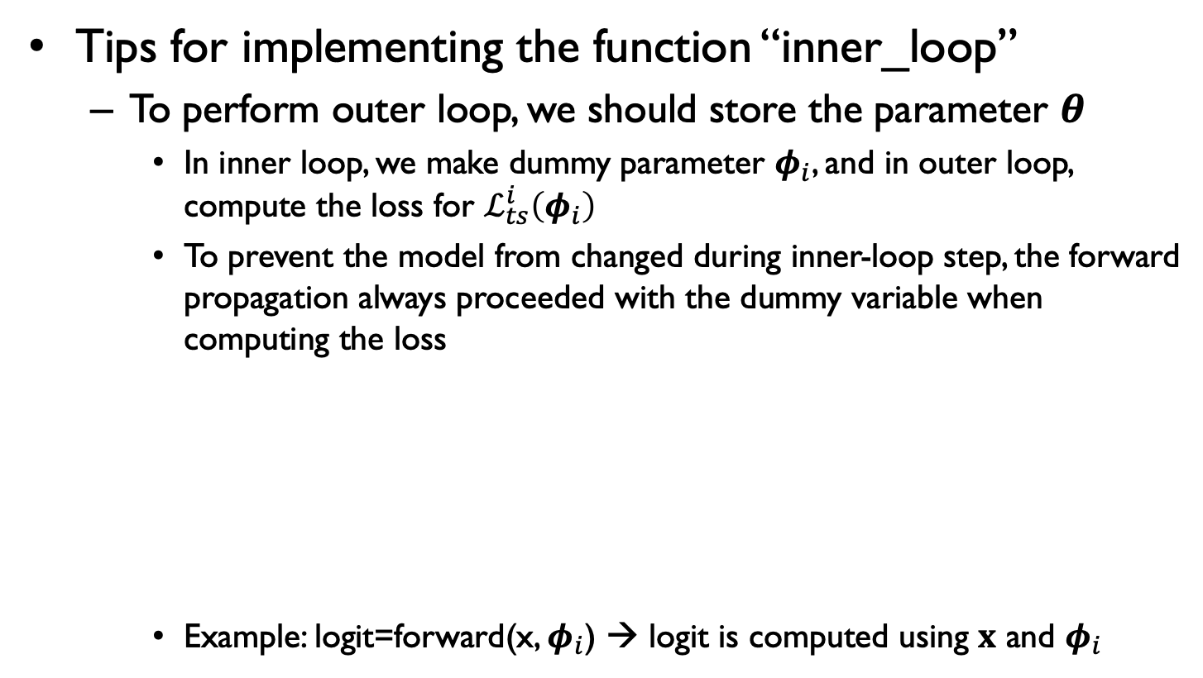
Goal of Lab for MAML
Tips for implementing the function “inner_loop”
To perform outer loop, we should store the parameter $θ$
In inner loop, we make dummy parameter $φ_{i}$, and in outer loop, compute the loss for $ℒ_{ts}^{i}\left(φ_{i}\right)$
To prevent the model from changed during inner-loop step, the forward propagation always proceeded with the dummy variable when computing the loss
Example: logit=forward(x, $φ_{i}$) → logit is computed using $x$ and $φ_{i}$

Slide 19
Goal of Lab for MAML
Tips for the dummy parameter
Use a function “torch.autograd.grad” to compute the gradient, and apply SGD to make the dummy parameter
To compute the Hessian internally, please set the argument create_graph = True
Reference

Slide 20
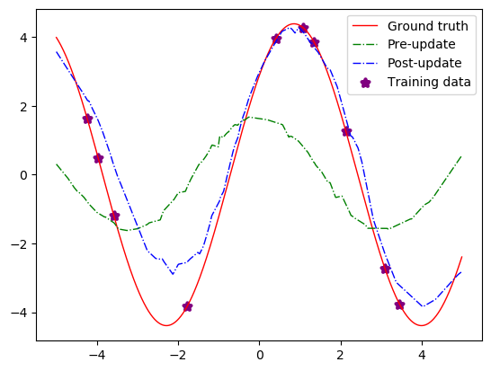
Goal of Lab for MAML
Results
You need to get the results as follows:
The shape of sine-wave could be different from this figure because of the randomness of dataset generation

Slide 21
Outline
Review of MAML and CNP
Goal of Lab
A Brief Explanation for Source Codes

Slide 22
Program Structure
Program structure mainly consists of three parts
Network module
Produces a trainable neural network through a function "ModelFactory”
Data_handler module
Declare a pre-defines loader that produces tasks for meta-learning
Trainer module
Meta-learning algorithms are implemented in this module
We need to complete scripts of MAML and CNP

Slide 23

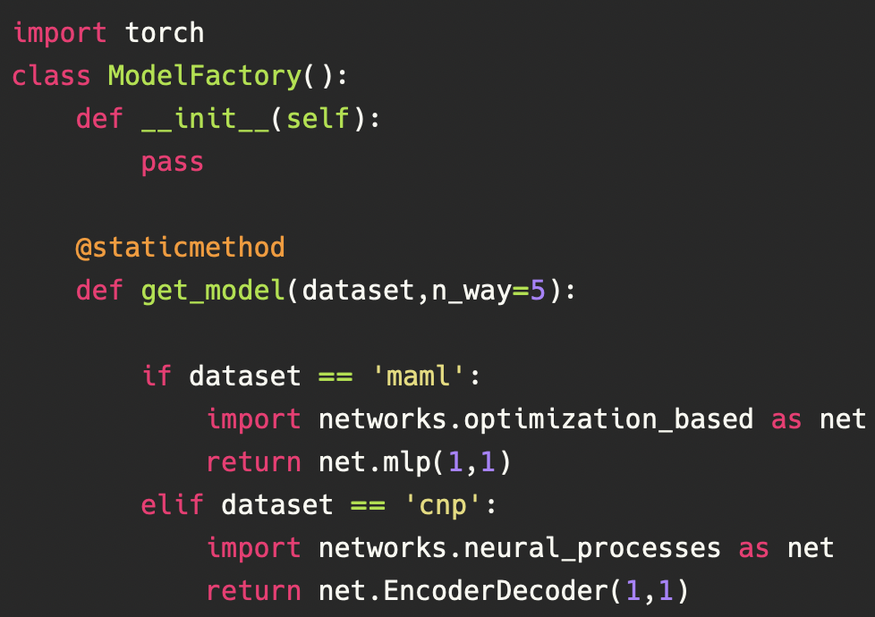
Program Structure
Program structure mainly consists of three parts
Network module
Produces a trainable neural network through a function "ModelFactory”
<ModelFactory>

Slide 24
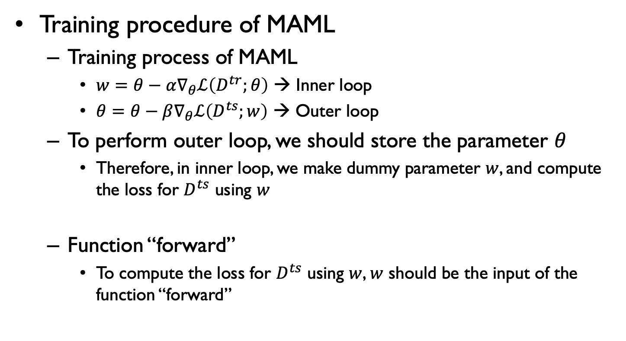
Program Structure
Training procedure of MAML
Training process of MAML
$w=θ−α∇_{θ}ℒ\left(D^{tr};θ\right)$ → Inner loop
$θ=θ−β∇_{θ}ℒ\left(D^{ts};w\right)$ → Outer loop
To perform outer loop, we should store the parameter $θ$
Therefore, in inner loop, we make dummy parameter $w$, and compute the loss for $D^{ts}$ using $w$
Function “forward”
To compute the loss for $D^{ts}$ using $w$, $w$ should be the input of the function “forward”

Slide 25
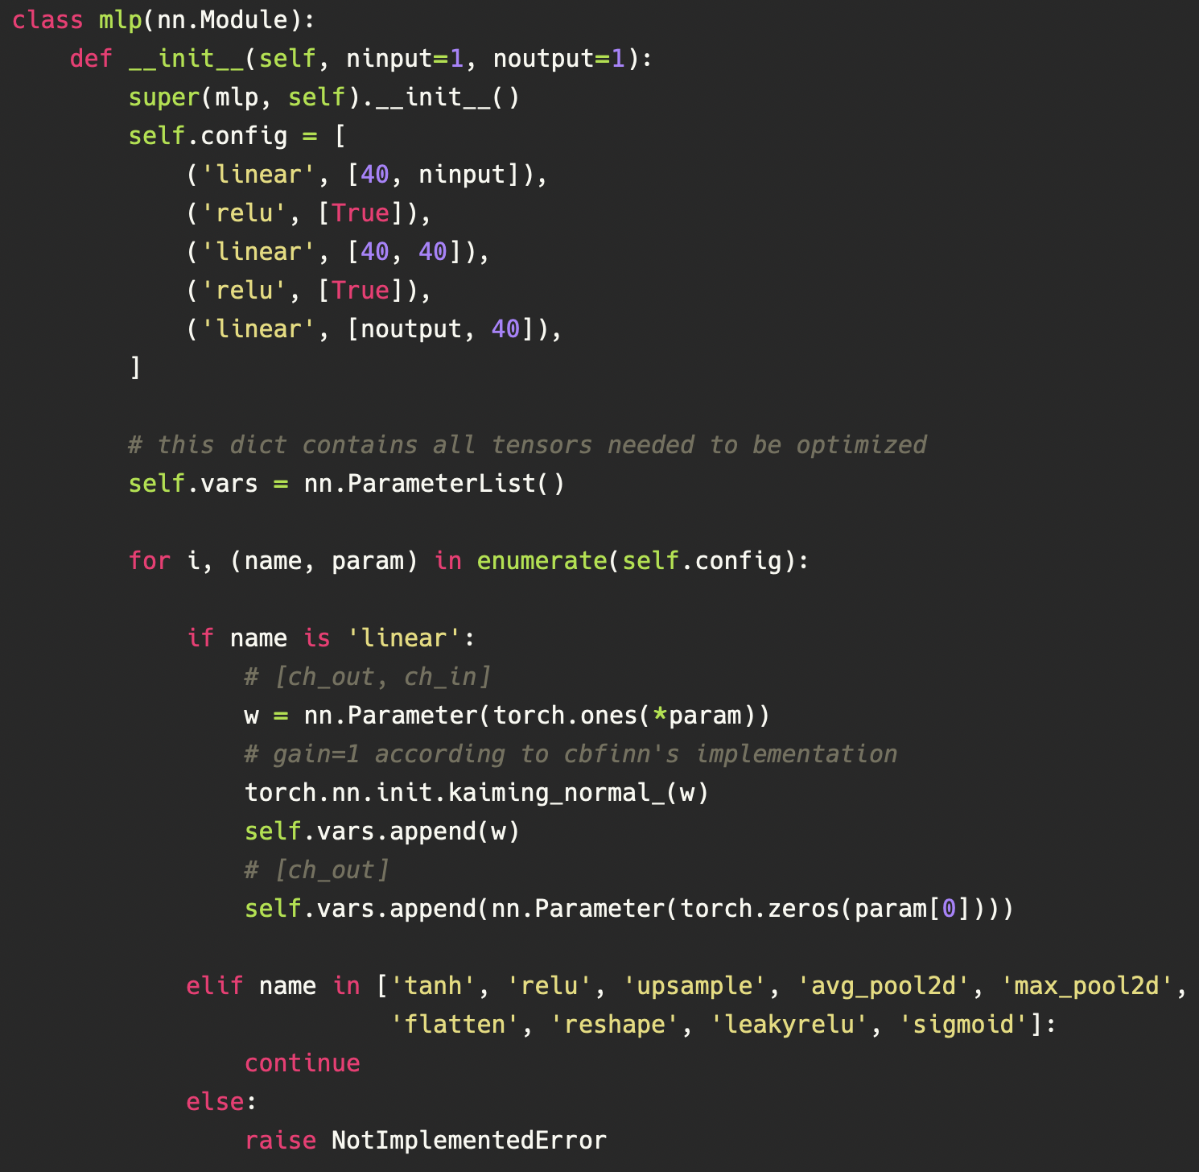
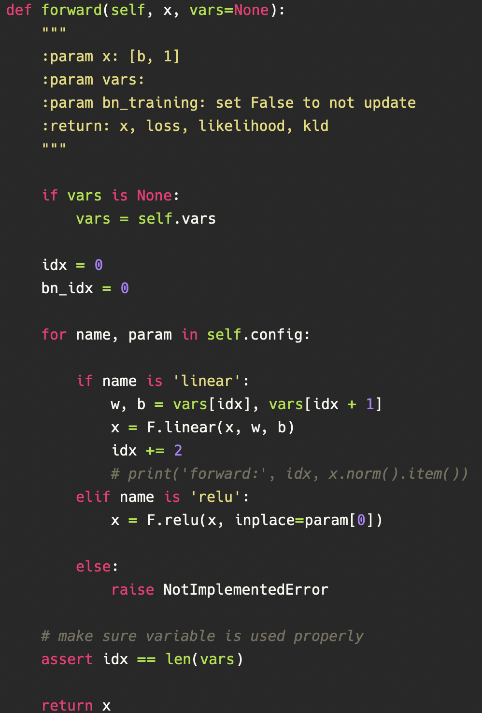
Program Structure
Dummy parameter
Network
Network architecture

Slide 26

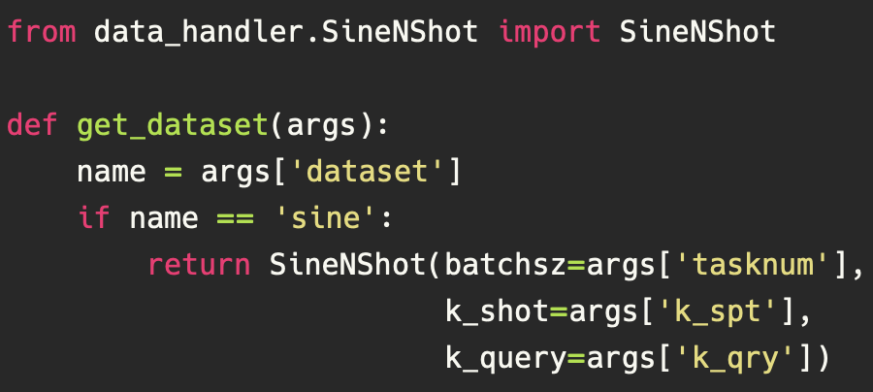
Program Structure
Program structure mainly consists of three parts
Data_handler module
Declare a pre-defines loader that produces tasks for meta-learning through a function “get_dataset”
SineNShot is a class that produces the sine-wave data for meta-learning

Slide 27
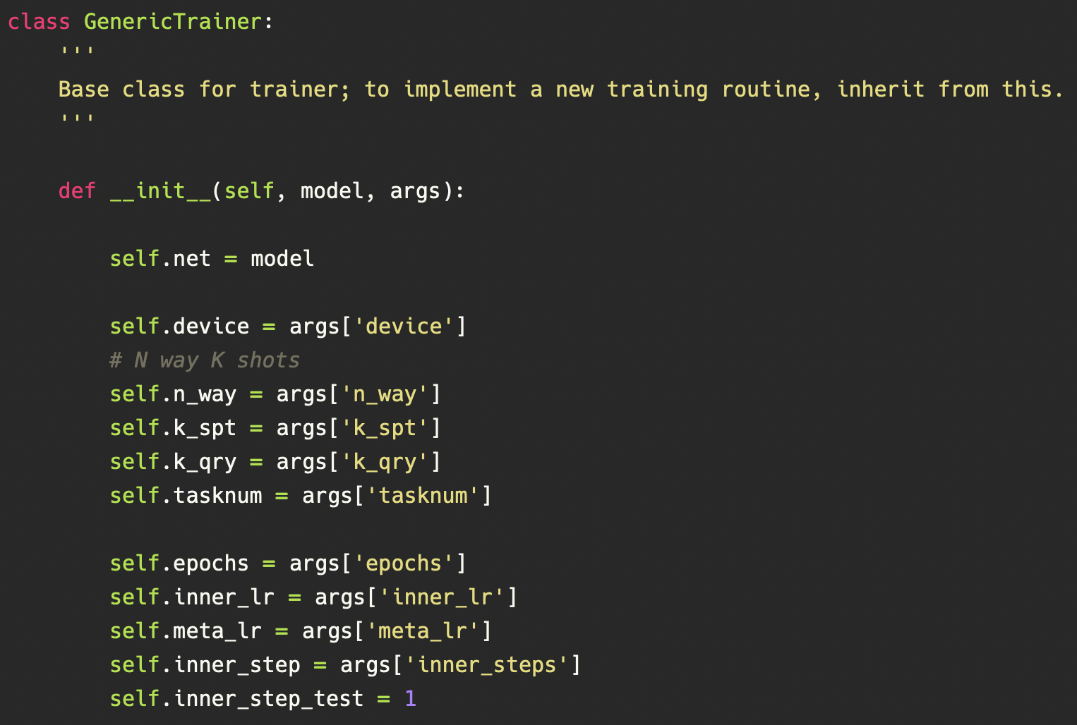
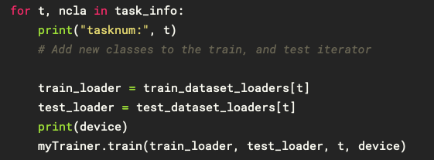
Program Structure
Program structure mainly consists of three parts
Trainer module
Meta-learning algorithms inherit the class “GenericTrainer”
Functions for train & evaluation is implemented, and hyperparameters are initialized in GenericTrainer

